Slide 1
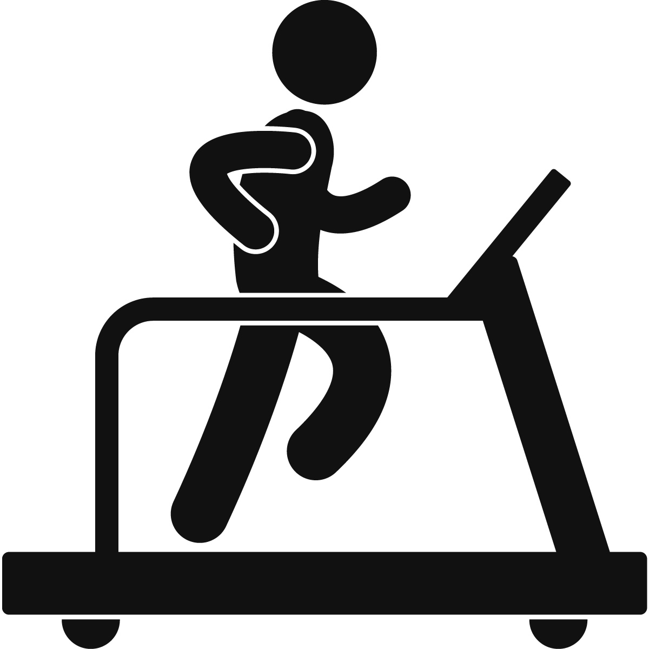
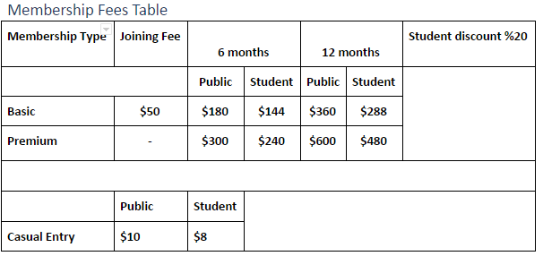






Homepage
Home Login/Signup Contact Info Booking Shop
Welcome to Riccarton gym, we aim our facilities to high school and university students. We offer a range of different services in our gym and online. We allow booking of basketball court and other courts for friends and other groups of who people who just want to have fun or want to practice. We also have a range of different products for our customers from a few energy drinks to different things such as weights for those who are really into their personal fitness. Our online store also offers a range of products. Prices can be found below. So don’t be shy sign up online now or come in store and have a chat.
Follow us on:

